Slide 1
Youth Gangs in Victorian and Edwardian London
Heather Shore
Cultural Studies and Humanities, Leeds Beckett University

Slide 2
Key Questions:
What was the character and extent of ‘gang’ conflict?
How did the CJS deal with gang crime?
Can we draw any lessons from historical gangs? How meaningful are comparisons?

Slide 3
Hooliganism
Youth gangs identified in British cities from 1870s
Manchester, Birmingham, Liverpool
London – Summer 1898

Slide 4
Who Were the Gangs?
My research (1882 – 1912):
41 prosecutions; 97 individuals
Old Bailey; London Police Courts

Slide 5
Gang Prosecutions - Ages

Slide 6
“The Clerkenwell Tragedy”:
Only 1 female defendant – Eliza Walters (15)
Manslaughter of 12-year-old Margaret Jane Smith in June 1897
1 found guilty of manslaughter
“Clerkenwell Pistol Gang”

Slide 7
“The Savages of the Slums”?
Occupations:
71 described as working
20 described as ‘labourers’
51 semi-skilled and manual workers
12 costermongers (market workers)

Slide 8
Territory:
Lambeth and Southwark (S); Islington and King’s Cross (N); Clerkenwell and Hackney (E)
Occasionally travelled significant distances for gang fights
Confrontations played out in close neighbourhoods and streets

Slide 9
Structural Factors:
Simple correlations between ‘slum-life’, unemployment and criminality do not work
Stigmatisation of areas by police
Proximity to manufacture, markets, employment opportunities
‘Respectable’ working-class areas; mixed demographics

Slide 10
Policing and Prosecution:
“During the last nine months there had been five cases of use of revolvers in this district. The police had the greatest difficulty in obtaining evidence, as various gangs of lads had become a terror to the neighbourhood” (Chief Insp. Fred Wensley, 1912)

Slide 11
Gang Prosecutions - Weapons

Slide 12
Charges and Sentencing:
65% charged with wounding
3 charges of murder; 1 manslaughter
Riot and assault; multiple charges
85% found guilty
Prison with HL, 1 and 18 mths
5 sentences to penal servitude, 3 to 10 years
1 reformatory
3 Borstal (from 1908)
Notes:
Moving on to charges and sentencing:
65% of the prosecutions were for wounding, there were three charges of murder, one for manslaughter and a few for riot and assault. The majority received guilty verdicts. It is important to note that many of the trials involved multiple defendants, and it is in these trials that the occasional not guilty verdict would be found.
The majority of the youths were sentenced to prison with hard labour, and five to penal servitude. Thomas Galliers received the ten-year sentence for the murder of Frederick Wilmore in 1882. Only one boy, William Bond, was sentenced to the reformatory (most were over 16 and thus too old), and from 1908, three youths were recommended to Borstal.

Slide 13
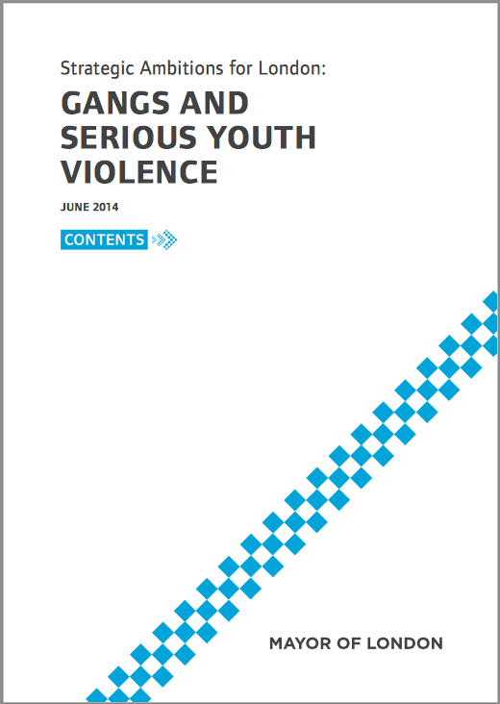
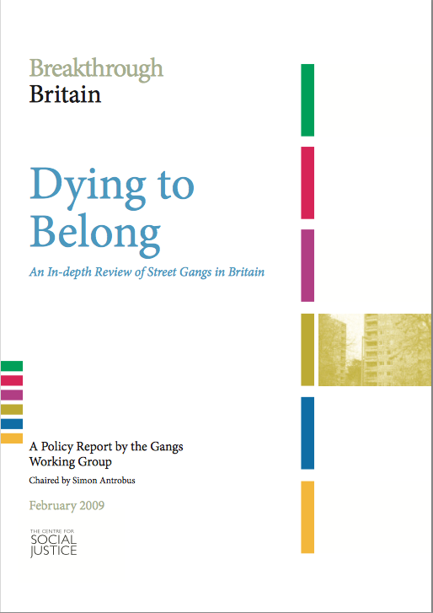
Conclusions:
Impact of drugs
Ethnic identity
Territory. Similar maps of gang activity over time.
2009 report from CSJ linked gang territory to employment and underemployment
Marginalising impact of unskilled, semi-skilled, low-paid work

Slide 14
Conclusions:
Press and control groups contribute to myths and stereotypes
Desistance – most youths moved out of offending
Interventions that worked – strong ethos of reform and community based strategies

Slide 15
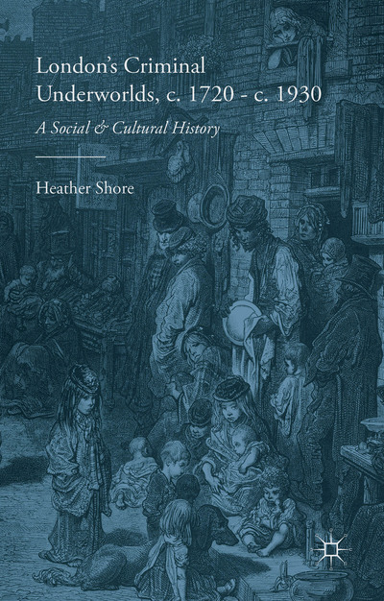
For further information see:
Heather Shore, London’s Criminal Underworlds, c. 1720 – c. 1930 (Palgrave Macmillan, 2015)
http://www.palgrave.com/page/detail/londons-criminal-underworlds-c.-1720-c.-1930-heather-shore/?isb=9780230304048

